Slide 1


ARTIFICIAL INTELLIGENCE &MACHINE LEARNING
RLVNSG SAGAR 21BK5A6606
K BHUPATHI REDDY 21BK5A6604

Slide 2
WELCOME TO EMBEDDED
SYSTEMS

Slide 3








GENERAL ELECTRONIC SYSTEM
INPUTS OUTPUTS
SYSTEM
INTELLIGENT DEVICE
INDICATOR/LED
SWITCH
SENSOR
LCD/DISPLAYS
KEYPAD/KEYBOARD
MOTORS
CARD READER/MODEM
ELECTRIACAL LOADS

Slide 4
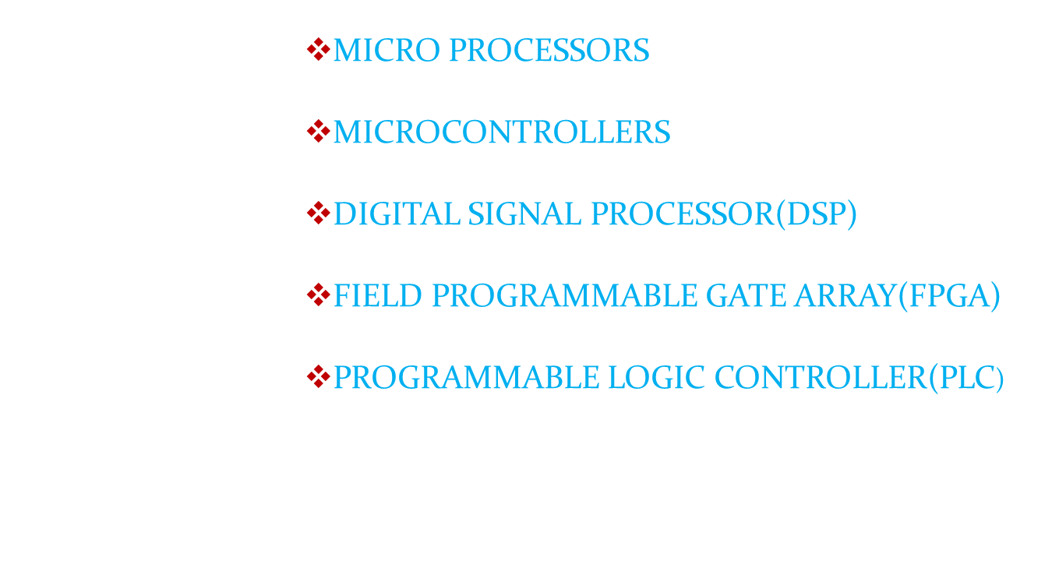
LIST OF INTELLIGENT DEVICES

Slide 5
DIFFERENT DOMAINS IN ELECTRONICS
S/W + H/W ELECTRONIC SYSTEM
C(or )ASM+MP(or)MC EMB SYSTEM
MATLAB + DSP D S P SYSTEM
VERILOG + FPGA VLSI SYSTEM
(or)VHDL
LADDER + PLC AUTOMATION
LOGIC

Slide 6
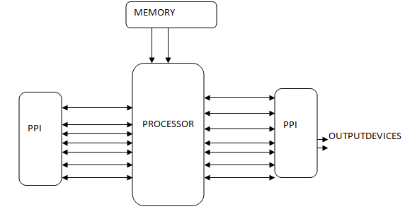
ELECTRONIC SYSTEM DESIGN
input devices

Slide 7
EVOLUTION OF PROCESSORS
The first microprocessor introduced by Intel Corporation in 1971 with 4-bit capacity.
4-bit -- 4001
8-bit -- 8085
16-bit – 8086/186/286/386
32-bit -- Pentium-I, II, III, IV
64-bit- core2duo, I-series processors

Slide 8
BASIC CHARACTERISTICS OF
EMBEDDED SYSTEMS

Slide 9
H/W & S/W combination
Application specific
Shift of work-365x24x7
Cannot be reprogrammable by the end-user

Slide 10
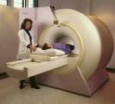
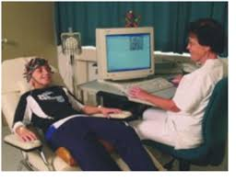
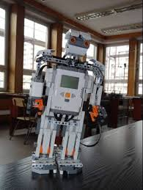
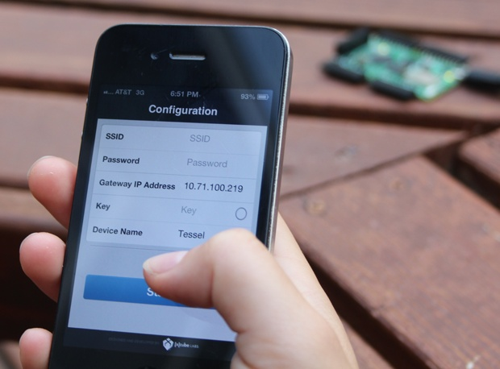
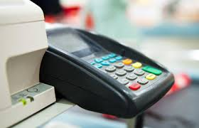
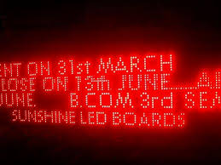
DIFFERENT APPLICATIONS

Slide 11
ELECTRONIC SYSTEM DESIGN
MICRO CONTROLLER UNIT
INPUTS
OUTPUTS

Slide 12
EVOLUTION OF CONTROLLERS
8-bit—8031, 8051, 8052
16-bit—pic 24fxxx series
32-bit—ARM Controllers(LPC series, STM series).

Slide 13
Applications of processors/controllers
Home & Consumer Electronics
Automotive,
Communication/ Telecom,
Medical,
Office,
Transport,
Railways,
Retail,
Energy / Power
Industrial,
Defense , Space, Aerospace,

Slide 14
Microprocessors/Microcontrollers used at Home?
Televisions
TV Remotes
Microwave Ovens
Calculators
Refrigerators
Washing Machines
etc…

Slide 15
Microprocessors/Microcontrollers used in Consumer Electronics?
personal digital assistants (PDAs)
mp3 players
mobile phones
videogame consoles
digital cameras
DVD players
printers.

Slide 16
Microprocessors/Microcontrollers used in Automotive segment
Anti-Lock Braking System (ABS)
Electronic Stability Control (ESC by Mercedes Benz & BMW)
Traction Control
Automatic Four Wheel Drive

Slide 17
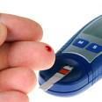
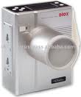
Microprocessors/Microcontrollers
Used in Medical?
X-RAY Generator
Blood Sugar Level Monitor

Slide 18
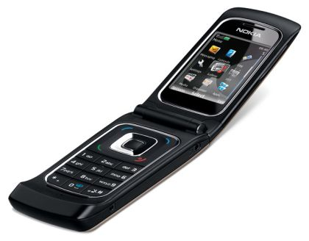
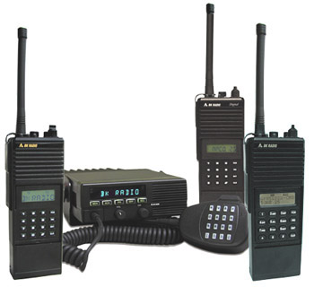
Microprocessors/Microcontrollers
Used in Telecom ?
Mobile Phone
Walkie – Talkie

Slide 19
Microprocessors/Microcontrollers used in Offices?
Phone
FAX
Scanner
Photo copier
Computers
networking devices
Attendance recording
Security Gadgets

Slide 20
Microprocessors/Microcontrollers used in Transport Sector?
GPS Tracking
Traffic signaling
Display boards
Toll Collection Gadjets
Security / survelence

Slide 21
Microprocessors/Microcontrollers used in Railways?
GPS Tracking
Traffic signaling
Display boards
Track Maintenance
Air conditioning
Public announcement systems
Security / surveillance

Slide 22
Microprocessors/Microcontrollers used in Retail Sector?
RFID,
POS (Point Of Sale)
Security/ surveillance ,
Bar code readers,
weighing,
Public Announcement systems,
Internet Kiosks (similar to public Telephone booth)

Slide 23
Microprocessors/Microcontrollers used in Industries?
PLCs,
Robots,
Security/ surveillance ,
Bar code readers,
weighing,
Public Announcement systems,

Slide 24
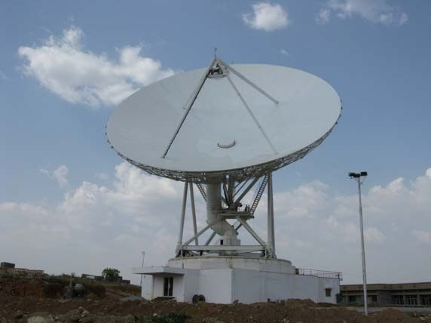
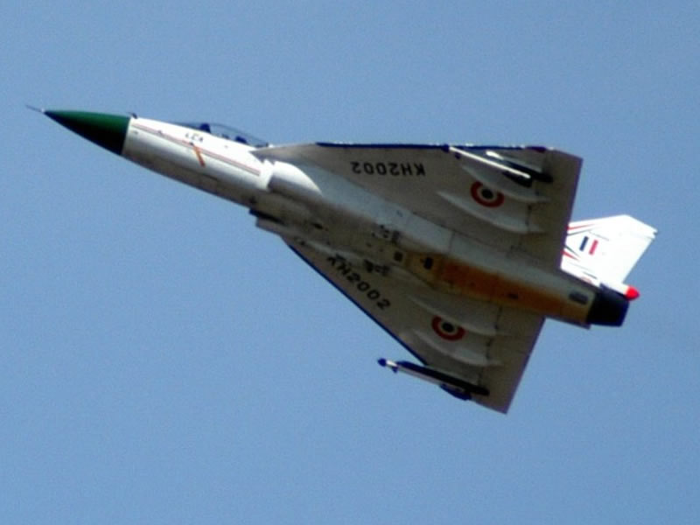
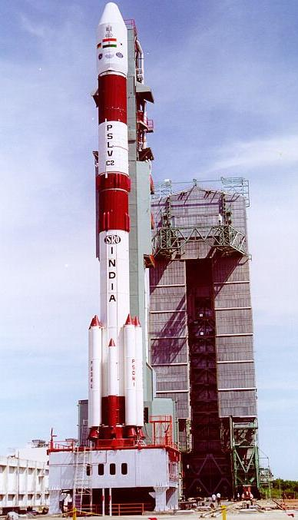
Microprocessors/Microcontrollers
Used in Defence, Space, aerospace sectors ?

Slide 25
Why Embedded Technology?
Chip Level Design & Developments associated with software programming are engaged to reduce the Component-Count in order
# to make System more Compact
# to cut down the power consumption considerably,
# to enhance the reliability and of course
# to slash down the price

Slide 26
Skills required to become Embedded Engineer:
Strong C &DS programming Skills
Embedded C, Python, Assembly
Protocols- UART, I2C,SPI, CAN &USB
Wireless : Wi-Fi, Xbee, GSM, BT
Different Target boards, Arduino, ARM boards, Raspberry Pi.
Device Drivers.

Slide 27
THANK YOU

